Slide 1


CSE211
Computer Organization and Design
Lecture : 3
Tutorial: 1
Practical: 0
Credit: 4
1

Slide 2
Overview
Register Transfer and Micro-operations
Register Transfer Language
Register Transfer
Bus and Memory Transfers
Logic Micro-operations
Shift Micro-operations
Arithmetic Logic Shift Unit

Slide 3
A | shift | register | is defined | as
a) | The | register | capable of | shifting information | to | another | register
b) | The | register | capable of | shifting information | eit | her to | the right | or | to | the | left
c) | The | register | capable of | shifting information | to | the rig | ht only
d) | The | register | capable of | shifting information | to | the lef | t only

Slide 4
Registers capable of shifting in one direction is
Universal shift register
Unidirectional shift register
Unipolar shift register
Unique shift register

Slide 5
Register Transfer Language
5
In computer science, register transfer language(RTL) is a kind of intermediate representation (IR) that is very close to assembly language, such as that which is used in a compiler. It is used to describe data flow at the register-transfer level of an architecture.
Digital Modules are frequently characterized in terms of
the registers they contain, and
the operations that are performed on data stored in them
The operations executed on the data in registers are called micro-operations e.g. shift, count, clear and load

Slide 6
Register Transfer Language
6
Internal hardware organization of a digital computer :
Set of registers and their functions
Sequence of microoperations performed on binary information stored in registers
Control signals that initiate the sequence of micro- operations (to perform the functions)

Slide 7
Register Transfer Language
7
Rather than specifying a digital system in words, a specific notation is used, Register Transfer Language
The symbolic notation used to describe the micro operation transfer among register is called a register transfer language
For any function of the computer, the register transfer language can be used to describe the (sequence of) micro-operations
Register transfer language
A symbolic language
A convenient tool for describing the internal organization of digital computers in concise/precise manner.

Slide 8
Following are some commonly used registers:
Accumulator:used to store data taken out from memory.
General Purpose Registers: This is used to store data intermediate results during program execution.
Special Purpose Registers: Users do not access these registers. These registers are for Computer system,
MAR: Memory Address Register:- holds the address for memory unit.
MBR: Memory Buffer Register stores instruction and
data received from the memory and sent from the memory.
PC: Program Counter points to the next instruction to be executed.
IR: Instruction Register holds the instruction to be executed.

Slide 9
Register Transfer Language
9
Registers are designated by capital letters, sometimes followed by numbers (e.g., A, R13, IR)
Often the names indicate function:
MAR
PC
IR
memory address register
program counter
instruction register
Registers and their contents can be viewed and represented in various ways
A register can be viewed as a single entity:
MAR

Slide 10
Register Transfer Language
10
Designation of a register
a register
portion of a register
a bit of a register
Common ways of drawing the block diagram of a register
Register Showing individual bits
R1
7 6 5 4 3 2 1 0
15
0
15
8 7 0
R2
PC(H)
PC(L)
Numbering of bits
Subfields

Slide 11
Register Transfer Language
11
•
Copying the contents of one register to another is a register transfer
•
A register transfer is indicated as
R2 ← R1
In this case the contents of register R1 are copied (loaded) into register R2
A simultaneous transfer of all bits from the source R1 to the destination register R2, during one clock pulse
Note that this is a non-destructive; i.e. the contents of R1 are not altered by copying (loading) them to R2

Slide 12
Register Transfer Language
12
•
A register transfer such as
R3 ← R5
Implies that the digital system has
the data lines from the source register (R5) to the destination register (R3)
Parallel load in the destination register (R3)

Slide 13
Control Functions
13
Often actions need to only occur if a certain condition is true
This is similar to an “if” statement in a programming language
In digital systems, this is often done via a control signal, called a control function
If the signal is 1, the action takes place
This is represented as:
P: R2 ← R1
Which means “if P = 1, then load the contents of register R1 into register R2”, i.e., if (P = 1) then (R2 ← R1)

Slide 14
Hardware Implementation of Controlled Transfers
14
Implementation of controlled transfer P: R2 ← R1
Block diagram
Control Circuit
P
Load
R2
Clock
n
R1
Timing diagram
t
t+1
Clock
Load
Transfer occurs here
The same clock controls the circuits that generate the control function and the destination register
Registers are assumed to use positive-edge-triggered flip-flops

Slide 15
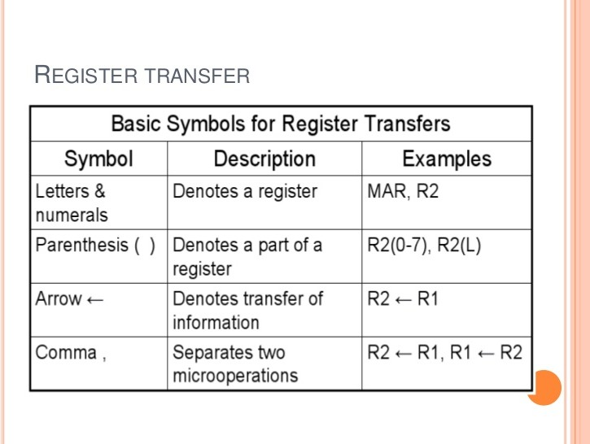

Slide 16
Connecting Registers - Bus Transfer
16
In a digital system with many registers, it is impractical to have data and control lines to directly allow each register to be loaded with the contents of every possible other registers
To completely connect n registers →
O(n²) cost
This is not a realistic approach to use in a large digital system
n(n-1) lines
Instead, take a different approach
Have one centralized set of circuits for data transfer – the bus
BUS STRUCTURE CONSISTS OF SET OF COMMON LINES, ONE FOR EACH BIT OF A REGISTER THROUGH WHICH BINARY INFORMATION IS TRANSFERRED ONE AT A TIME
Have control circuits to select which register is the source, and which is the destination
CSE 211

Slide 17
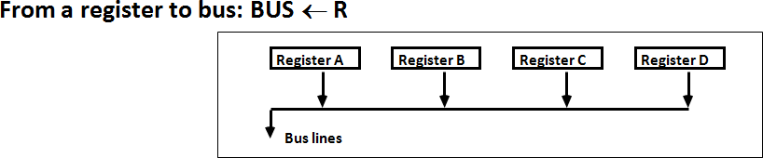
Connecting Registers - Bus Transfer
17
One way of constructing common bus system is with multiplexers
Multiplexer selects the source register whose binary information is kept on the bus.
Construction of bus system for 4 register (Next Fig)
4 bit register X 4
four 4X1 multiplexer
Bus selection S0, S1

Slide 18
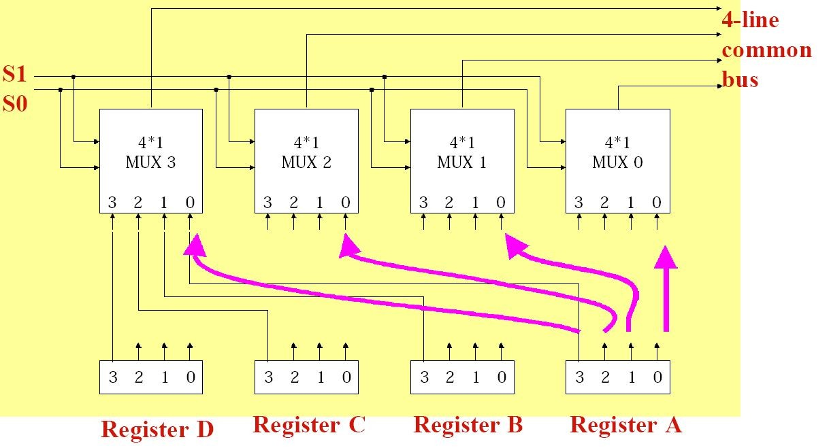
Connecting Registers - Bus Transfer
18

Slide 19
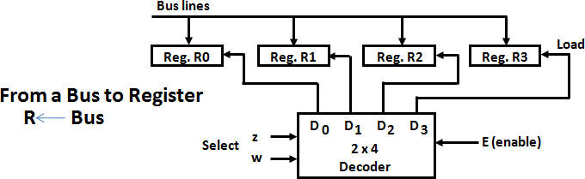
Connecting Registers - Bus Transfer
19

